Slide 1
APOLOGETICS
IN ONE LESSON
almost
Ai1L.net
Lesson 21
Regarding Miracles

Slide 2
What do you think is a good definition of a miracle?
1

Slide 3
What are some barriers that may cause people to struggle to accept miracles?
2

Slide 4
To what degree does “extraordinary claims require extraordinary evidence”?
3

Slide 5
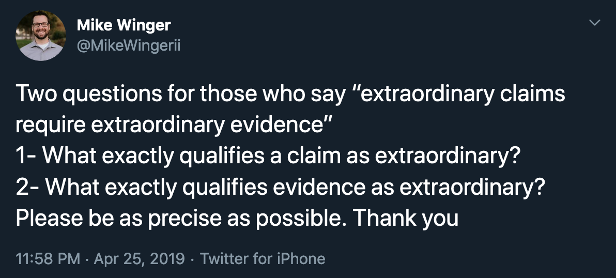
http://bit.ly/Ai1LExtraordinary

Slide 6
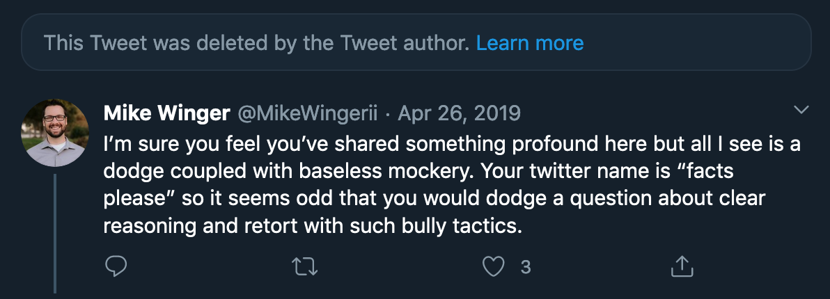
Response 1

Slide 7
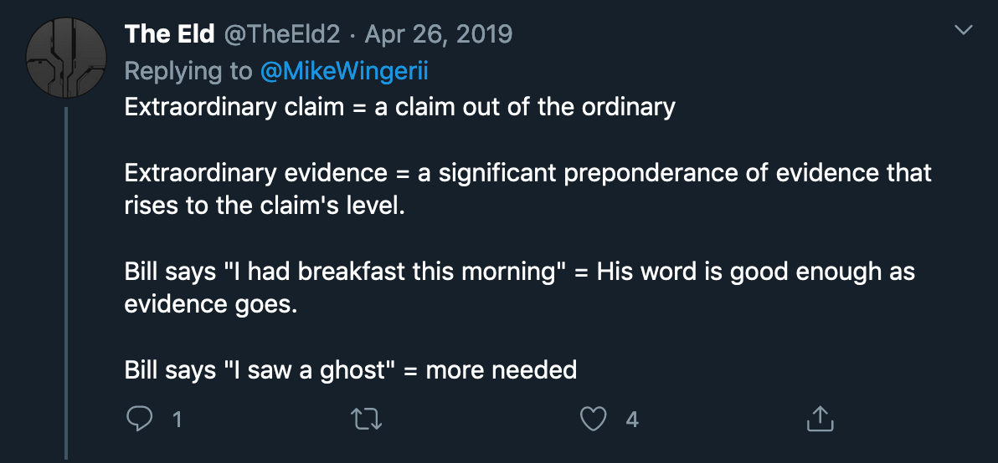
Response 2

Slide 8
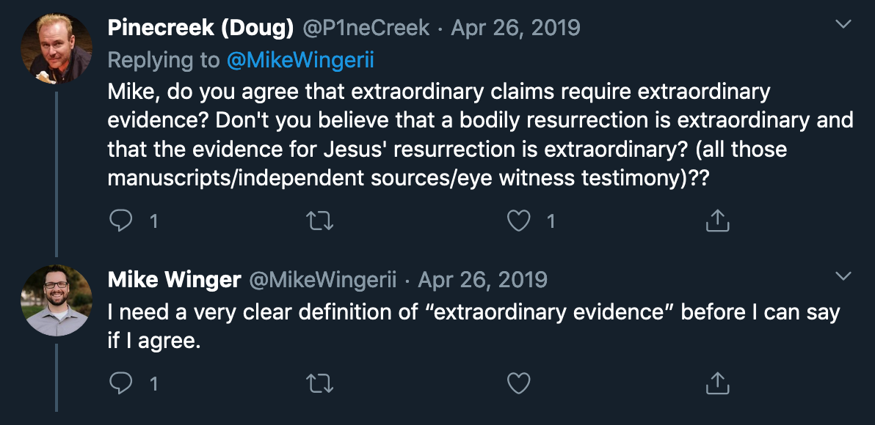
Response 3

Slide 9

Response 4

Slide 10
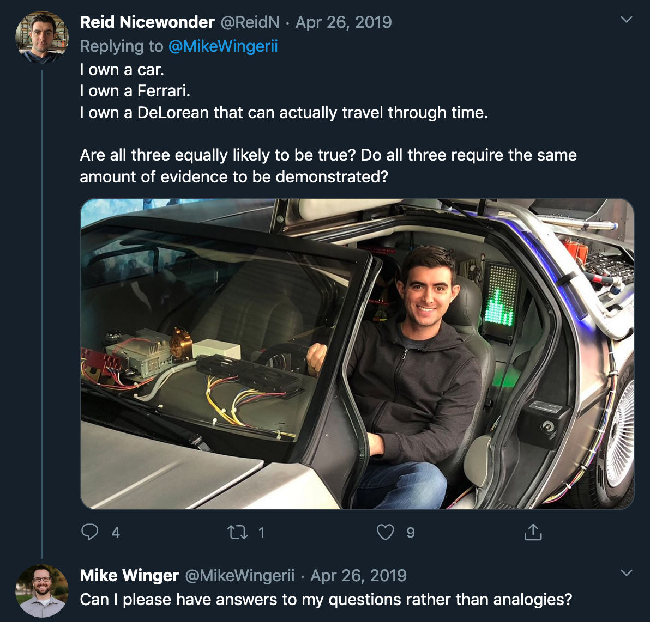
Response 5

Slide 11
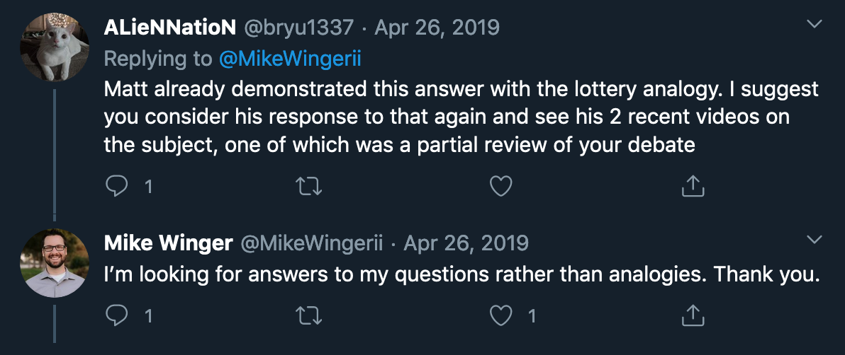
Response 6

Slide 12
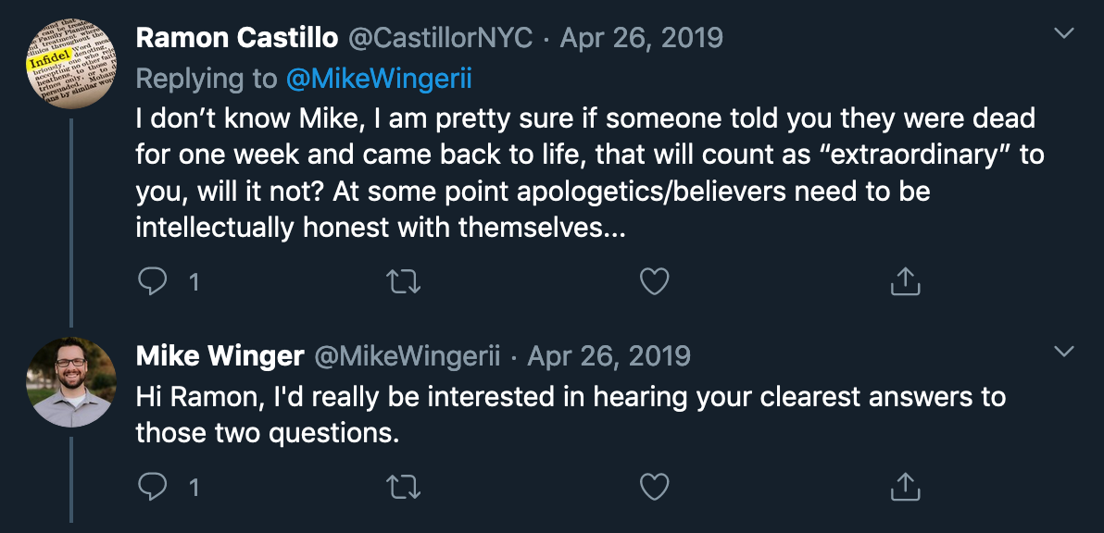
Response 7

Slide 13
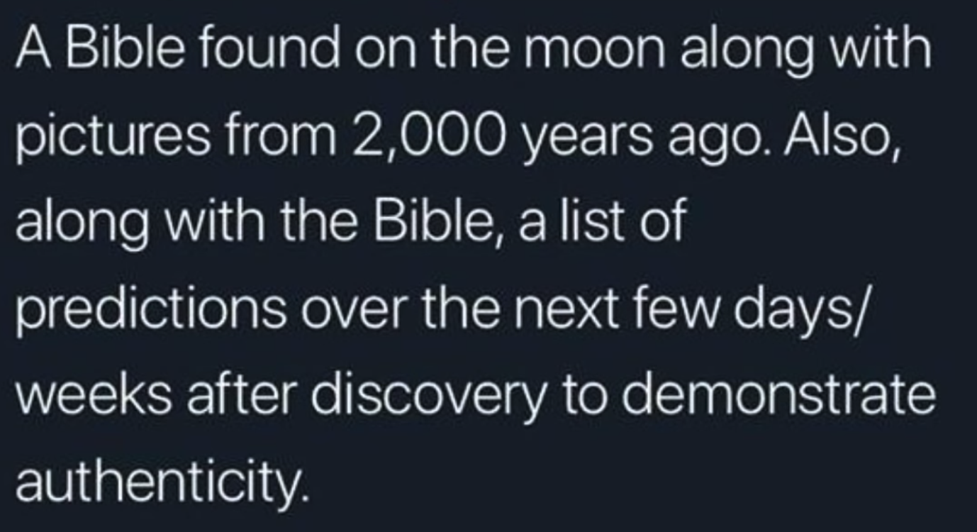
Extraordinary evidence 1

Slide 14
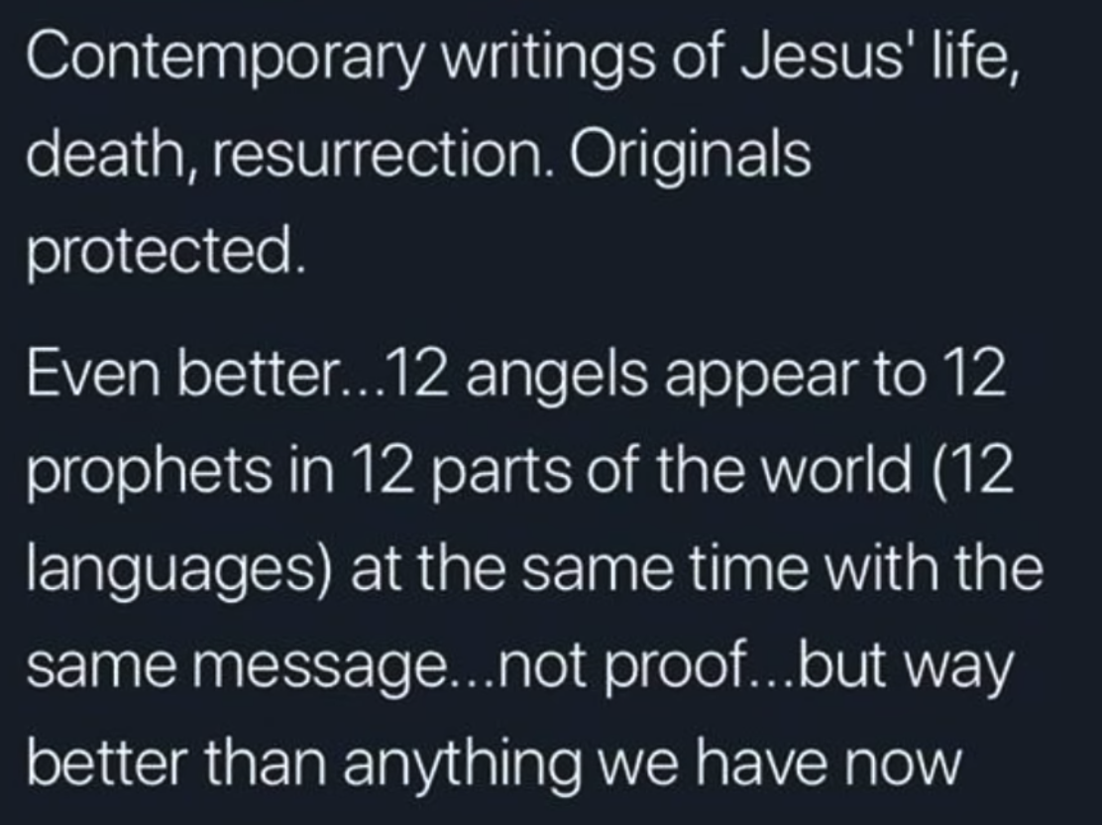
Extraordinary evidence 2

Slide 15
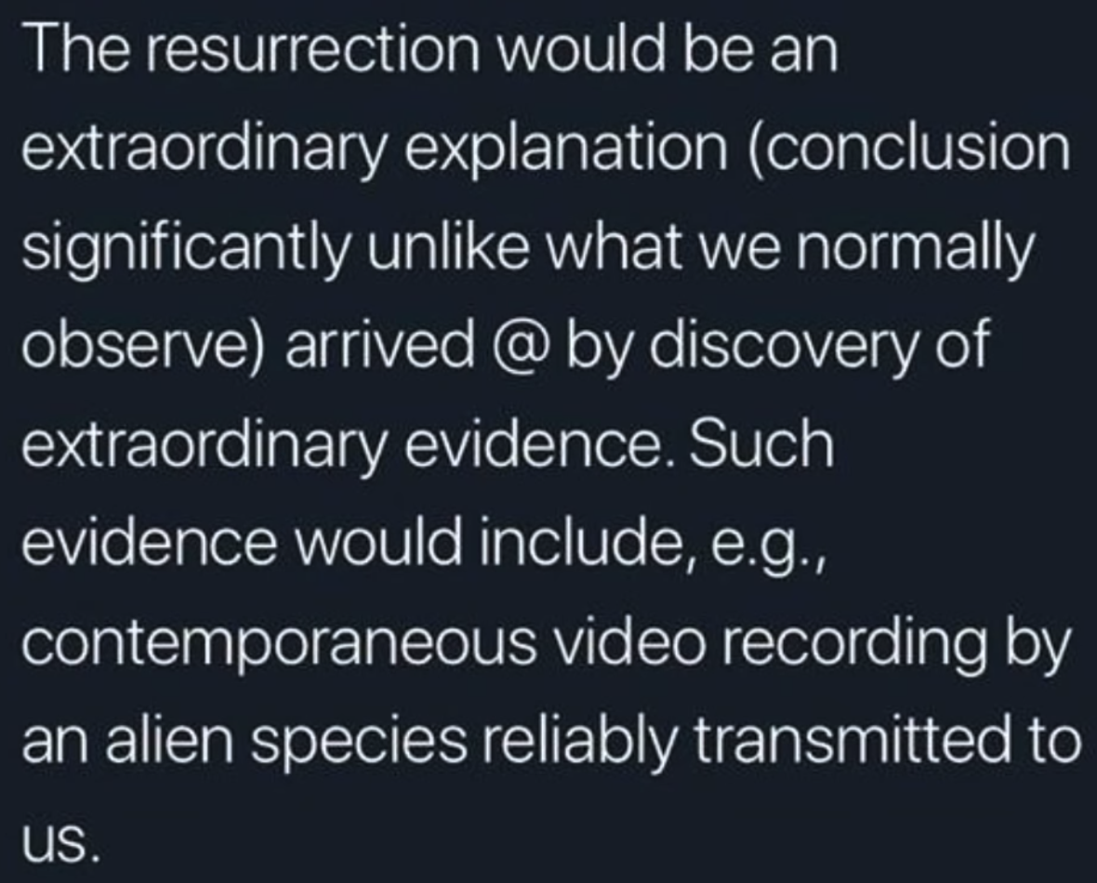
Extraordinary evidence 3

Slide 16
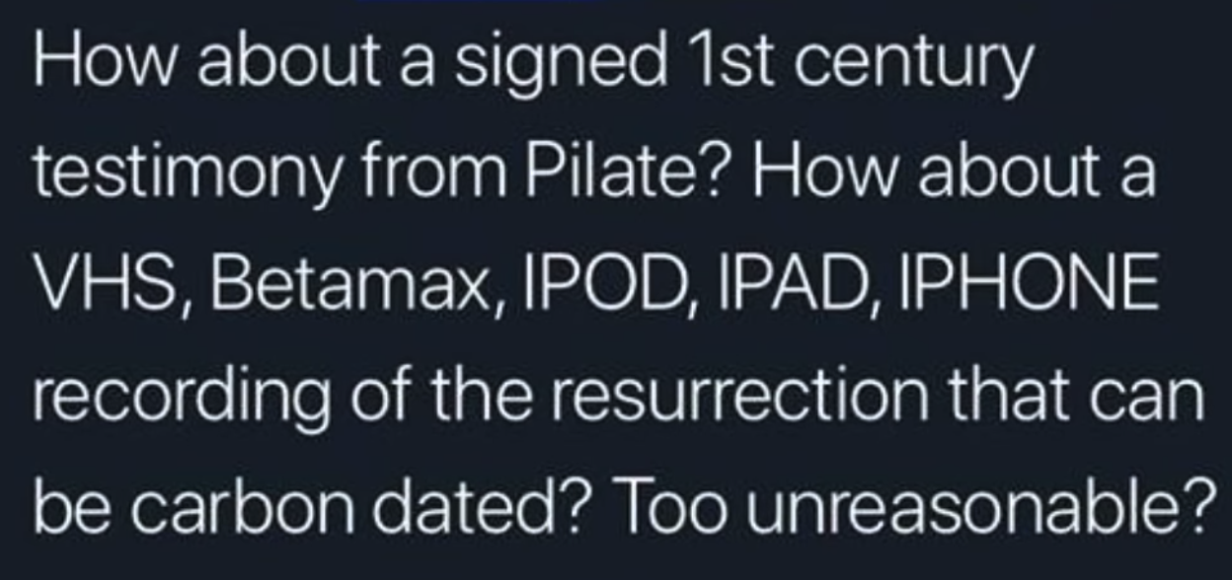
Extraordinary evidence 4

Slide 17
What are some considerations and thoughts that may be useful for defending miracles?
4

